Slide 1
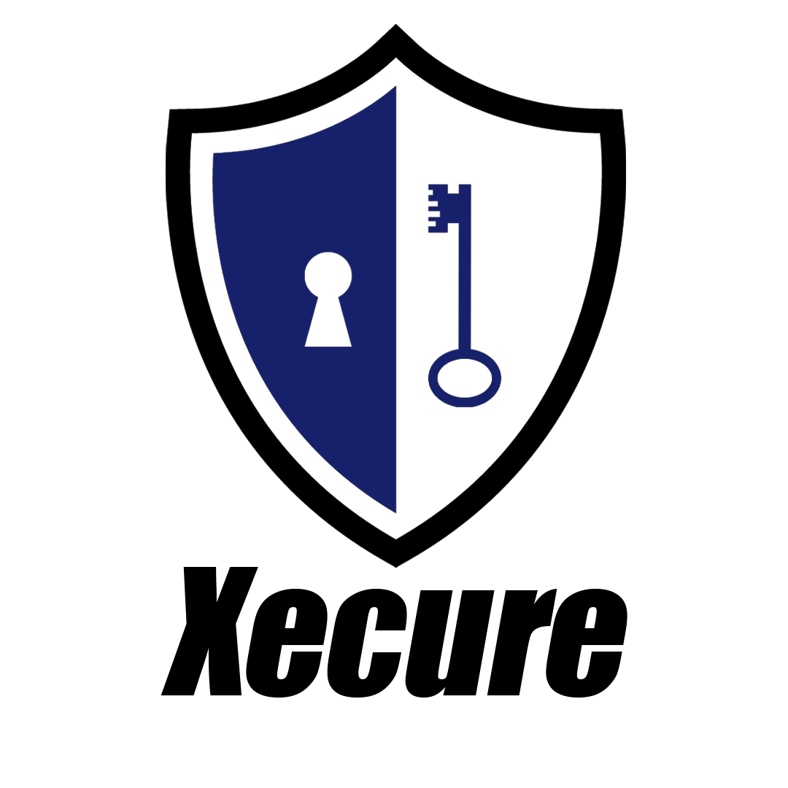
Xecure Password Manager
CSCI 499 Senior Project Defense

Slide 2

Introduction
Management of passwords is one of the most important aspects of Cybersecurity.
Strong and unique passwords are vital for account security.
Most users have far too many online accounts to remember a unique password for each account.
The average user has over 90 different online accounts.
Notes:
The management of passwords is one of the most important aspects of Cybersecurity and it is imperative that users implement and practice safe password management practices. In order to ensure safe password management practices users must create strong and unique passwords for every one of their accounts. User should then be able to log into all their accounts in an efficient and effortless manner. Unfortunately, most users have far too many online accounts to remember a unique password for each account. A survey conducted by Nate Lord (2020) indicates that the average user has over 90 different online accounts.

Slide 3

Problem
There is a limit to how many passwords a user can remember.
A Google survey found that 52 percent of users reuse the same password for multiple accounts.
Reusing passwords:
Leaves users vulnerable to intrusion attacks.
Result in data loss, monetary loss and more.
IBM (2020) found that the average cost of a data breach is $3.68 million, while a data breach in the healthcare industry is estimated to cost around $7.13million.
Data breaches in the United States are among the costliest averaging around $8.64 million.
Notes:
There is a limit to how many passwords a user can remember, and this survey revealed how the majority of users struggle with the number of passwords they manage, which usually leads to users reusing the same passwords. A Google Online Security Survey (2019) found that 52 percent of users reuse the same password for multiple accounts.
The practice of reusing passwords leaves users vulnerable to intrusion attacks, which can result in data loss, monetary loss and more. A report conducted by IBM (2020) found that the average cost of a data breach is $3.68 million, while a data breach in the healthcare industry is estimated to cost around $7.13million. Furthermore, IBM found that data breaches in the United States are among the costliest averaging around $8.64 million.

Slide 4
Solution
Password managers can easily eliminate all the difficulties that are associated with having unique and complex passwords.
Password managers store all the passwords in a secured vault that can be accessed with a “master” password.
No need to remember multiple passwords
Greatly reduces the chances of having multiple accounts compromised.
Notes:
By using a password manager users can easily manage unique passwords for their accounts while eliminating all the difficulties that are associated with complex passwords.
With a password manager users can store all their passwords in a secured vault that can be accessed with a “master” password.
This eliminates the need to remember multiple passwords and greatly reduces the chances of having multiple accounts compromised.
The management of passwords is one of the most important and overlooked factors of information security. In order eliminate the difficulties that come with remembering passwords it is recommended that user utilize a password management application in order to protect their accounts.

Slide 5




Xecure Password Manager
Xecure is a password manager application for Windows computers.
Securely stores and manages log in information.
Uses MYSQL database to store user data.
Uses encryption and hashing to protect user data.

Slide 6
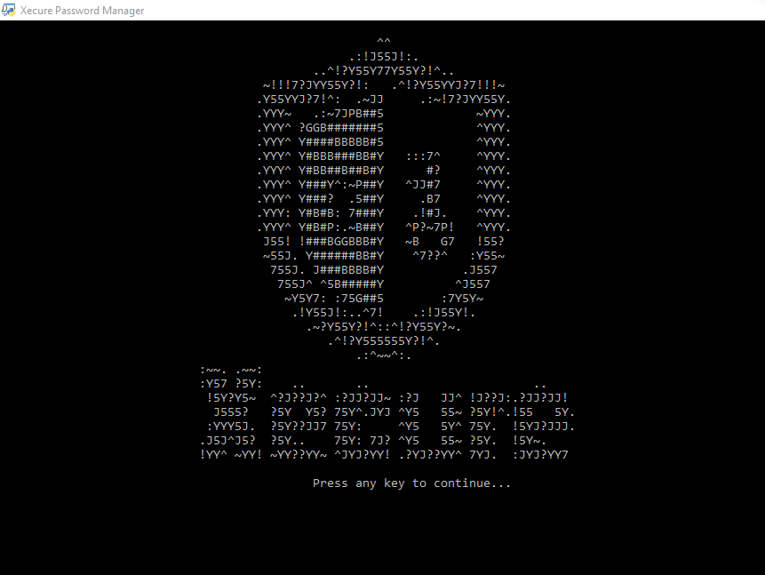
Solution
Uses SHA-256 to authenticate users.
Uses AES-256 to encrypt data before sending it to the database.
Uses prepared statements to prevent SQL injections.
Uses a local database.
Notes:
Talk about the SHA hashing
The AES encryption
The Database
The application can also copy a record’s password into the computer’s clipboard
This password will then be wiped from the clipboard after fifteen seconds or if the user closes the application. The application has connectivity to a MYSQL database that is used to securely store the user’s information. In order to protect the information in the database the application uses the well-established AES encryption and SHA256 hashing algorithms. Additionally, the users have the option to generate unique and complex passwords for every record entered. Users will also have the option of entering their own passwords and the application will guide them every step of the way. Lastly, the program has features that allows users to reset their “master” password and email if they forget it or wish to change it.
The application is called Xecure Password Manager and it was inspired by applications like KeePass, and LastPass and it contains all of the major features that these application have. All of the previously mentioned features are the standard in the password manager market, and they will be included in the Xecure Password Manager application at no cost to the users. In addition to being a free application, Xecure Password Manager will not contain any ads, there are no password or account limits, and it will not store or use user data for any other purpose. This is what separates Xecure Password Manager from the competition.

Slide 7

functions
Users can create accounts
Create and save records
Generate strong password for records
Retrieve records
Update records
Email authentication
Live Demo…

Slide 8

Test Plan
Created a document containing test cases.
Fixed findings.
Created a usability test for volunteers.
Fixed any new findings

Slide 9

Test Results
Users wanted a way to back out of menus.
Users did not want to remember a user ID.
Verification Codes were too complicated.
Email addresses were case sensitive.
Recovery emails needed more details.
Notes:
There is a limit to how many passwords a user can remember, and this survey revealed how the majority of users struggle with the number of passwords they manage, which usually leads to users reusing the same passwords. A Google Online Security Survey (2019) found that 52 percent of users reuse the same password for multiple accounts.
The practice of reusing passwords leaves users vulnerable to intrusion attacks, which can result in data loss, monetary loss and more. A report conducted by IBM (2020) found that the average cost of a data breach is $3.68 million, while a data breach in the healthcare industry is estimated to cost around $7.13million. Furthermore, IBM found that data breaches in the United States are among the costliest averaging around $8.64 million.

Slide 10
Major Findings
Application does not sanitize clipboard if user force closes the application.
Cannot properly exit application until the fifteen seconds of the clipboard are done.
Cannot properly logout of the application until the fifteen seconds of the clipboard are done.
No email validation.

Slide 11
Vulnerabilities
Password not being sanitized after force closing application.
Unauthorized user gaining access to the system.
System becoming infected with malware or spyware.
Database deletion or corruption.
Shoulder surfing.

Slide 12
Future Enhancements
Email Validation
Password Strength Detector
Better Input Validation
Better Password Rules
Clipboard Exit/Logout Fix
Additional Authentication Methods
Password Verification Prompt
Better Lockout Feature
Full Implementation of Password Generator
Prevent Leading Zeros
Prevent Force Closing App (Tentative)
GUI Interface (Tentative)

Slide 13
references
Google. (2019, February). Online Security Survey. Google. Retrieved from https://services.google.com/fh/files/blogs/google_security_infographic.pdf.
Greig, J. (2020, July 29). IBM finds cyberattacks costing companies nearly $4 million per breach. TechRepublic. Retrieved from https://www.techrepublic.com/article/ibm-finds-cyberattacks-costing-companies-nearly-4-million-per-breach/.
Lord, N. (2020, September 29). Uncovering password habits: Are users' password security habits improving? (infographic). Digital Guardian. Retrieved from https://digitalguardian.com/blog/uncovering-password-habits-are-users-password-security-habits-improving-infographic.
Mavituna, F. (2022, March 14). SQL Injection Cheat Sheet. Netsparker. Retrieved from https://www.invicti.com/blog/web-security/sql-injection-cheat-sheet/

Slide 14
Motivation (TENTATIVE)
The practice of securing networks, systems and other digital infrastructures are an essential aspect to information systems and cybersecurity. As a Cybersecurity major, I strive to broaden these previously mentioned technical and functional skills. The development of this application will provide me with a deeper understanding of various hashing and encryption practices that are vital to the field of cybersecurity. It will also strengthen my problem solving and debugging skills that are necessary as a programmer. The program will also require an understanding of the various methods that attackers used to exploit passwords. This will expand my computer analysis skills and provides me with additional resources and solutions that can be used to thwart malicious attacks. By creating this application and developing the previously mentioned skills I will be able to set myself apart from the competitions and I will be able to demonstrate my expertise as a cybersecurity professional.
The practice of securing networks, systems and other digital infrastructures are an essential aspect to information systems and cybersecurity. As a Cybersecurity major, I strive to broaden these previously mentioned technical and functional skills. The development of this application will provide me with a deeper understanding of various hashing and encryption practices that are vital to the field of cybersecurity. It will also strengthen my problem solving and debugging skills that are necessary as a programmer. The program will also require an understanding of the various methods that attackers used to exploit passwords. This will expand my computer analysis skills and provides me with additional resources and solutions that can be used to thwart malicious attacks. By creating this application and developing the previously mentioned skills I will be able to set myself apart from the competitions and I will be able to demonstrate my expertise as a cybersecurity professional.

